Slide 1

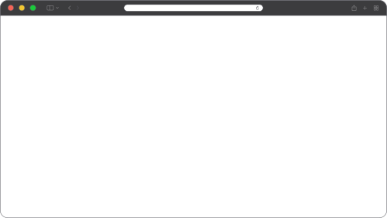

Web Vulnerability
Research
By : Ramadhan Amizudin
MCC-2024

Slide 2



Course Structure
01
02
03
Theory
Hands-on / Exercise
Homework

Slide 3



< Prologue >

Slide 4



WHO AM I
Ramadhan Amizudin
@rempahrz
https://rz.my

Slide 5

Virtual
Machine
Credential
Exercise Folder
Text Editor
The Usual Command
Username : student
Password : mcc2024#@!
/home/student/classroom
SublimeText
$ ./bin/start.sh
$ ./bin/stop.sh

Slide 6

Theory
PHP - The Language
Laravel Framework

Slide 7
PHP - The Language
Application Input
Strings
Classess and Objects

Slide 8
PHP Fundamentals
PHP is an interpreted language and as such
Supports a full object-oriented programming interface
Is dynamically typed
Does not provide any real memory safety features
Does not provide any real support for concurrency
Utilizes very little reflection
Supports custom serialization

Slide 9
PHP Application Input
$GLOBALS – Global variables defined in the application
$_SERVER – Access client and response data (eg: req/res HEADER)
$_REQUEST – Any GET/POST request parameters
$_POST – Any POST request parameters
$_GET – Any GET request parameters
$_FILES – HTTP File Upload variables
$_ENV – Any PHP environment variables
$_COOKIE – Any cookies parameters
$_SESSION – Session variables

Slide 10
PHP Application Input
$_GET / $_POST / $_COOKIE / $_REQUEST
Super global variable to access user-input, unfiltered by default.
$_GET = URL Query
$_POST = POST parameter
$_COOKIE = Cookie
$_REQUEST = $_GET+$_POST order depending on PHP setting “request_order” and “variables_order”

Slide 11
PHP Application Input
$_FILES - An associative array of item(file) uploaded via HTTP POST.
$_FILES[’userfile’][’name’] = File name of uploaded file, user controlled, sanitized by basename() by default
$_FILES[’userfile’][’type’] = The mime type of uploaded file, user controlled, unfiltered by default
$_FILES[’userfile’][’size’] = The size in bytes
$_FILES[’userfile’][’tmp_name’] = The temporary file location was stored on the server
$_FILES[’userfile’][’error’] = The error code associated with this file upload.
$_FILES[’userfile’][’full_path’] = The file local (user) file path, user controlled, unfiltered by default

Slide 12
PHP Application Input
$_SERVER
Server and execution environment information. Unfiltered by default. HTTP request header is stored in $_SERVER with variable name start with HTTP_, all in capital case, and non-alphanumeric character is replaced with _
Example:
$_SERVER[’HTTP_HOST’] = Host header
$_SERVER[’HTTP_X_REAL_IP’] = X-Real-IP Header

Slide 13
PHP Strings
A string literal can be specified in four different ways:
1. Single quoted
2. Double quoted
3. Heredoc syntax
4. Nowdoc syntax
Read more: https://www.php.net/manual/en/language.oop5.inheritance.php

Slide 14
PHP Strings - Single Quoted
The simplest way to specify a string is to enclose it in single quotes (the character ').
echo 'this is a simple string';
echo 'You can also have embedded newlines in
strings this way as it is
okay to do';

Slide 15
PHP Strings - Double Quoted
If the string is enclosed in double-quotes ("), PHP will interpret the following escape sequences for special characters.
The most important feature of double-quoted strings is the fact that variable names/function call will be expanded.

Slide 16
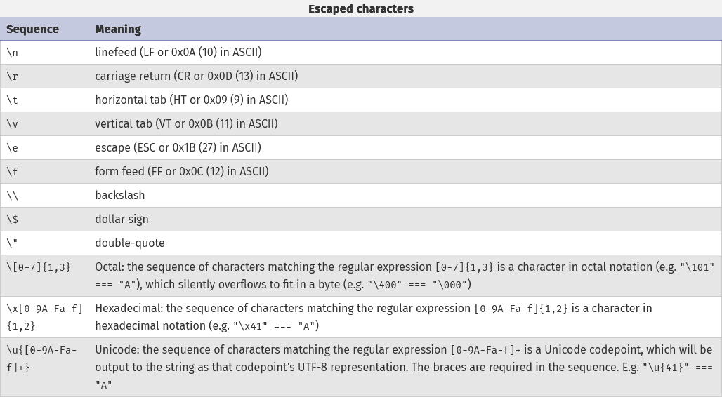
PHP Strings - Double Quoted

Slide 17
PHP Strings - Heredoc
A third way to delimit strings is the heredoc syntax: <<<. After this operator, an identifier is provided, then a newline. The string itself follows, and then the same identifier again to close the quotation. Works the same as double quoted strings. It just uses a string as starting and ending marker.
$bar = <<<EOT
foo
EOT;

Slide 18
PHP Strings - Nowdoc
Nowdocs are to single-quoted strings what heredocs are to double-quoted strings. A nowdoc is specified similarly to a heredoc, but no String interpolation is done inside a nowdoc.
<?php
echo <<<'EOD'
Example of string spanning multiple lines
using nowdoc syntax. Backslashes are always treated literally,
e.g. \\ and \'.
EOD;

Slide 19
PHP Classes and Objects
Class Visibility
Inheritance
Namespaces

Slide 20
PHP Classes and Objects
Classes
We can encapsulate code into a class, which can contain properties and methods of different visibility.
Public visibility
Anyone can access public properties or methods
Private visibility
Can only accessed by the class that defines the property or method

Slide 21
PHP Classes and Objects
Protected visibility
Can be accessed by the class that defines the property or method and by inheriting and parent classes.

Slide 22
PHP Classes and Objects
Inheritance
Inheritance is a well-established programming principle, and PHP makes use of this principle in its object model. This principle will affect the way many classes and objects relate to one another.
For example, when extending a class, the subclass inherits all of the public and protected methods, properties and constants from the parent class. Unless a class overrides those methods, they will retain their original functionality.
Read more: https://www.php.net/manual/en/language.oop5.inheritance.php

Slide 23
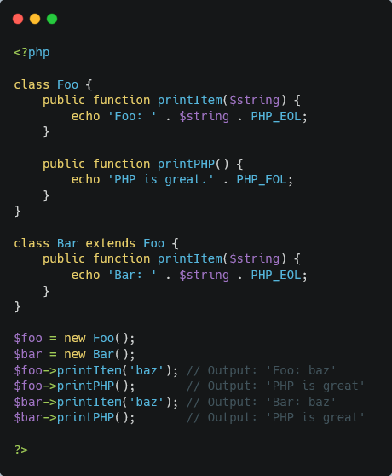
PHP Classes and Objects

Slide 24
PHP Classes and Objects
Namespace
What are namespaces? In the broadest definition namespaces are a way of encapsulating items. This can be seen as an abstract concept in many places.
In the PHP world, namespaces are designed to solve two problems that authors of libraries and applications encounter when creating re-usable code elements such as classes or functions.
Read more: https://www.php.net/manual/en/language.oop5.inheritance.php

Slide 25
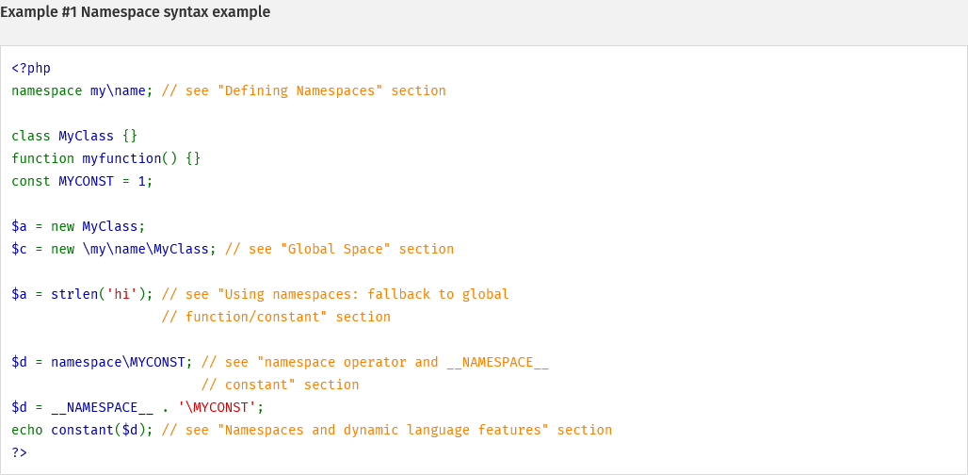
PHP Classes and Objects

Slide 26

Laravel
Framework

Slide 27
Laravel - The Framework
We will speed run learning Laravel framework in 10 minutes
Overview
Routing
Middleware
User Input
File Upload Handling

Slide 28
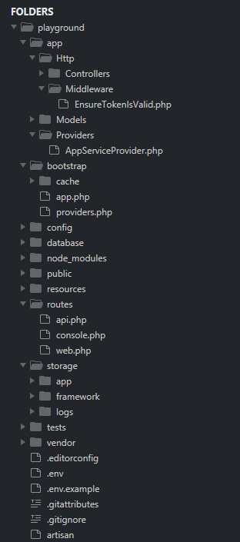
Controller
Middleware
Application Bootstrap
Configuration
Database Migration/Seeder
“Public” Facing Folder
Routing
Storage
.env file

Slide 29
Overview
Controller
Application logic is in this folder
Middleware
Imagine middleware as pre-exec logic checker/another logic. Everything go thru middleware (if defined) before executing any code in Controller
Application Bootstrap
This is the Laravel framework start. If you are lost, this folder is right place to investigate.
Configuration/.env file
This is where application-defined their configuration.

Slide 30
Overview
Database Migration/Seeder
All the application database definition/schema placed in this folder, and seeder is application database default/init value.
“Public” Facing Folder
Web server document rooted pointed to this folder. Everything is this folder is accessible
Storage Folder
All related to cache/session stored in this folder, including logs, etc.
Routing Folder
All routing/navigation definition stored in this folder
Read more: https://laravel.com/docs/11.x/structure#the-root-app-directory

Slide 31
Routing
Multiple way defining routing
Start with routes/web.php - this is default file for apps routing
Route::get('/greeting', function () { <--------------- GET request /greeting will return hello world
return 'Hello World';
});
Route::get('/', function () { <--------------- GET request / will render welcome page, but
return view('welcome');
})->middleware('isTokenValid'); <--------------- the request will be checked by isTokenValid middleware
Route::prefix('admin')->group(function () { <--------------- Route group
Route::get('/users', function () {
// Matches The "/admin/users" URL
});
});

Slide 32
Routing
Usually the route file look like this.
use App\Http\Controllers\UserController;
Route::get('/user', [UserController::class, 'index']);
GET request to /user will invoke method index in UserController class
Location of controller is in app/Http/Controllers/UserController.php

Slide 33
Routing
There are more with routes/api.php. By default in bootstrap/app.php
return Application::configure(basePath: dirname(__DIR__))
->withRouting(
web: __DIR__.'/../routes/web.php',
api: __DIR__.'/../routes/api.php',
commands: __DIR__.'/../routes/console.php',
health: '/up',
)
it mean all route in api.php will automatically have prefix /api unless defined otherwise
return Application::configure(basePath: dirname(__DIR__))
->withRouting(
api: __DIR__.'/../routes/api.php',
apiPrefix: 'api/admin'

Slide 34
Routing
Available Router Method
Route::get($uri, $callback);
Route::post($uri, $callback);
Route::put($uri, $callback);
Route::patch($uri, $callback);
Route::delete($uri, $callback);
Route::options($uri, $callback);
Route::any($uri, $callback);
Route::match(['get', 'post', $method..], $uri, $callback);
Read more: https://laravel.com/docs/11.x/routing

Slide 35
Middleware
There are multiple way to define middleware.
Global Middleware
Route-based Middleware
Controller-based Middleware
Middleware can be set via alias, class or group. All middleware alias is defined in bootstrap/app.php file

Slide 36
Middleware
Global Middleware is defined in bootstrap/app.php file
->withMiddleware(function (Middleware $middleware) {
$middleware->use([
\Illuminate\Foundation\Http\Middleware\InvokeDeferredCallbacks::class,
// \Illuminate\Http\Middleware\TrustHosts::class,
\Illuminate\Http\Middleware\TrustProxies::class,
\Illuminate\Http\Middleware\HandleCors::class,
\Illuminate\Foundation\Http\Middleware\PreventRequestsDuringMaintenance::class,
\Illuminate\Http\Middleware\ValidatePostSize::class,
\Illuminate\Foundation\Http\Middleware\TrimStrings::class,
\Illuminate\Foundation\Http\Middleware\ConvertEmptyStringsToNull::class,
]);
})

Slide 37
Middleware
For route-based middleware it look like this.
Route::get('/', function () {
return view('welcome');
})->middleware('isTokenValid');
isTokenValid is middleware alias, open up bootstrap/app.php will reveal which class responsible for handling this
->withMiddleware(function (Middleware $middleware) {
$middleware->alias([
'isTokenValid' => \App\Http\Middleware\EnsureTokenIsValid::class,
]);
})
EnsureTokenIsValid class is responsible for handling isTokenValid, and the class file is located in
app/Http/Middleware/EnsureTokenIsValid.php

Slide 38
Middleware
Or by using the class name directly
Route::get('/', function () {
return view('welcome');
})->middleware(\App\Http\Middleware\EnsureTokenIsValid::class);
EnsureTokenIsValid class is responsible for handling isTokenValid, and the class file is located in
app/Http/Middleware/EnsureTokenIsValid.php

Slide 39
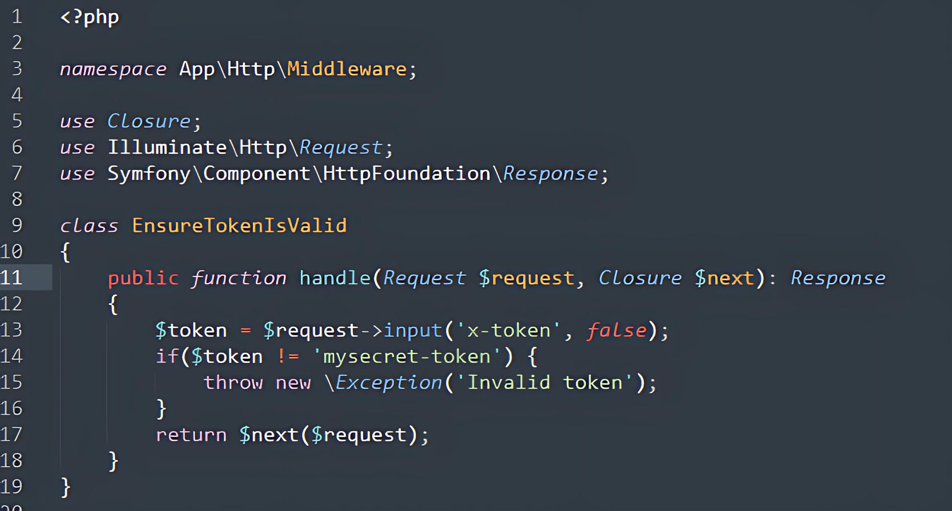
Middleware

Slide 40
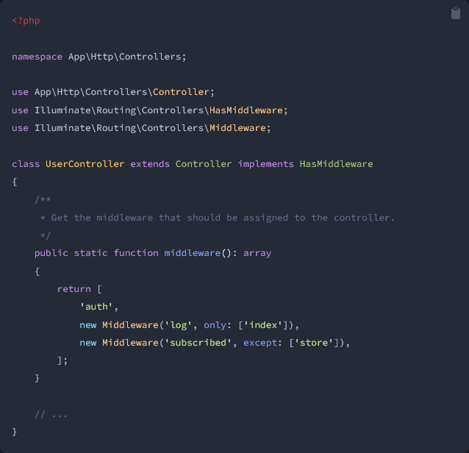
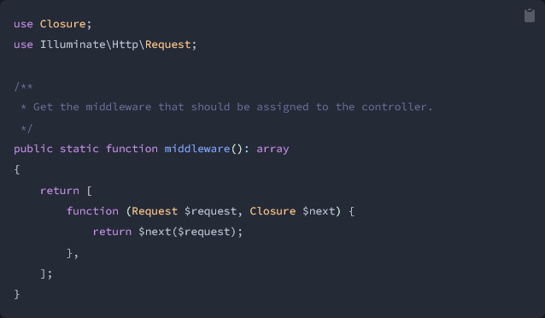
Middleware
In controller middleware

Slide 41
Different between Version
For Laravel <= 10
Middleware is defined in file: app/Http/Kernel.php

Slide 42
User Input
The most basic of all is
$input = $request->all();
All request will be assign to $input regardless of request method
GET /?var1=b or
POST /
var1=b
access via $input[’var1']
$name = $request->input('name'); <-- will take user input from GET or POST
$name = $request->input('name', ‘sally’); <-- same but with default value

Slide 43
User Input
$input = $request->query(‘name’); <-- Only from query string
$query = $request->query(); <-- take all from query string
Accessing data from json.
$name = $request->input('user.name');
Request: {”user”:{”name”:”aaa”}}
From header
$value = $request->header('X-Header-Name');

Slide 44
File Upload Handling
Accessing getting file upload.
$photo = $request->file('photo') <-- file upload via parameter photo
Getting file extension of uploaded file
$server_side_extension = $photo->extension();
$client_side_extension = $photo->getClientOriginalExtension();
Storing uploaded file.. there tons of way!
->store($foldername)
$path = Storage::putFile('photo', $request->file('photo'));
Read more:
https://laravel.com/docs/11.x/filesystem
https://laravel.com/docs/11.x/requests#files

